Slide 1
Lecture 20 Binary Search Tree

Slide 2
Motivation
Key difference between sorted list and unsorted list.
 | Unsorted List | Sorted List
RetrieveItem | O(N) | O(logN)
InsertItem | O(1) | O(N)

Slide 3
Motivation
Key difference between sorted list and unsorted list.
 | Unsorted List | Sorted List
RetrieveItem | O(N) | O(logN)
InsertItem | O(1) | O(N)
Can we improve this operation?

Slide 4

Tree Data Structure

Slide 5
Tree Data Structure
leaves
Branches
root

Slide 6
Tree Data Structure
Tree
Collection of nodes linked to each other (similar to linked lists)
Each node can have 0 or more children (successor nodes)
Each node (except the root) has exactly one parent (predecessor node)
This means that there is exactly one path to go from the root to any other node
Tree
Not Tree

Slide 7
Tree Data Structure
Terminology
Root ⇒ node with no parent
Leaf ⇒ node(s) with no child
Interior ⇒ non-leaf nodes
Root node
Interior nodes
Leaf nodes

Slide 8
Tree Data Structure
Terminology
Level ⇒ number of ancestors (parent or parent’s parent or …) up to the root (distance from the root)
Height ⇒ number of levels
Some books use height = highest level in the tree
Level 0
Height = 3
Level 1
Level 2

Slide 9
Binary Tree
Characteristics
Tree with 0 – 2 children per node
No child
One left child
One right child
One left child and one right child
Binary Tree

Slide 10
Binary Tree
Characteristics
Every node is the parent of two smaller trees (subtree)
Left subtree
Right subtree
Left subtree
Right subtree
Binary Tree

Slide 11
Binary Tree
Full tree
A binary tree is full if each node is either a leaf or possesses exactly two child nodes.
Complete tree
A binary tree is complete if all levels (except possibly the last) are completely full, and the last level has all its nodes to the left side.

Slide 12
Binary Tree
Full tree
A binary tree is full if each node is either a leaf or possesses exactly two child nodes.
Complete tree
A binary tree is complete if all levels (except possibly the last) are completely full, and the last level has all its nodes to the left side.

Slide 13
Binary Tree
Full tree
A binary tree is full if each node is either a leaf or possesses exactly two child nodes.
Complete tree
A binary tree is complete if all levels (except possibly the last) are completely full, and the last level has all its nodes to the left side.
Neither full nor complete

Slide 14
Binary Tree
Full tree
A binary tree is full if each node is either a leaf or possesses exactly two child nodes.
Complete tree
A binary tree is complete if all levels (except possibly the last) are completely full, and the last level has all its nodes to the left side.

Slide 15
Binary Tree
Full tree
A binary tree is full if each node is either a leaf or possesses exactly two child nodes.
Complete tree
A binary tree is complete if all levels (except possibly the last) are completely full, and the last level has all its nodes to the left side.
Full but not complete

Slide 16
Binary Tree
Full tree
A binary tree is full if each node is either a leaf or possesses exactly two child nodes.
Complete tree
A binary tree is complete if all levels (except possibly the last) are completely full, and the last level has all its nodes to the left side.

Slide 17
Binary Tree
Full tree
A binary tree is full if each node is either a leaf or possesses exactly two child nodes.
Complete tree
A binary tree is complete if all levels (except possibly the last) are completely full, and the last level has all its nodes to the left side.
Not full but complete

Slide 18
Binary Tree
Full tree
A binary tree is full if each node is either a leaf or possesses exactly two child nodes.
Complete tree
A binary tree is complete if all levels (except possibly the last) are completely full, and the last level has all its nodes to the left side.

Slide 19
Binary Tree
Full tree
A binary tree is full if each node is either a leaf or possesses exactly two child nodes.
Complete tree
A binary tree is complete if all levels (except possibly the last) are completely full, and the last level has all its nodes to the left side.
Full and complete

Slide 20
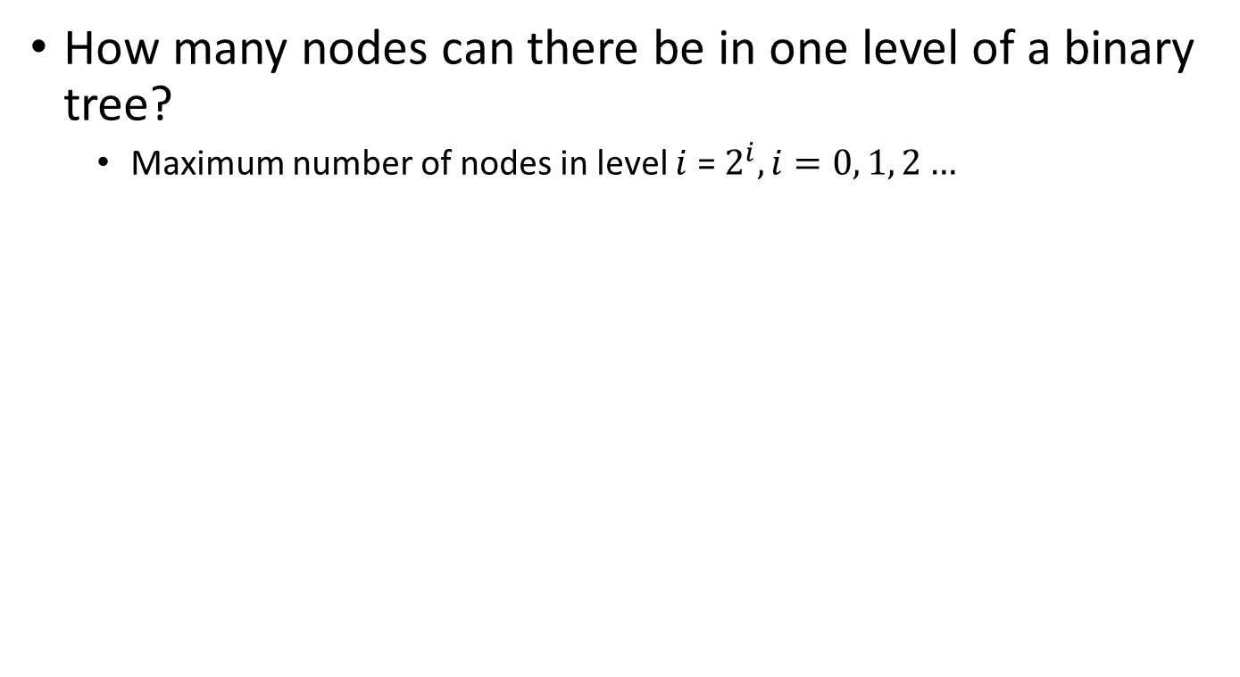



Binary Tree
Level 0
Level 1
Level 2

Slide 21
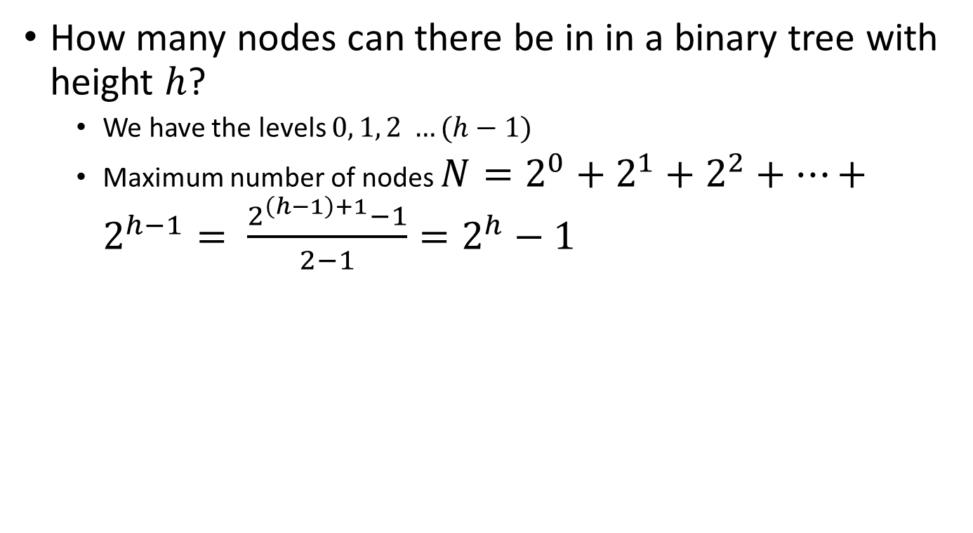
Binary Tree
Level 0
Level 1
Level 2

Slide 22
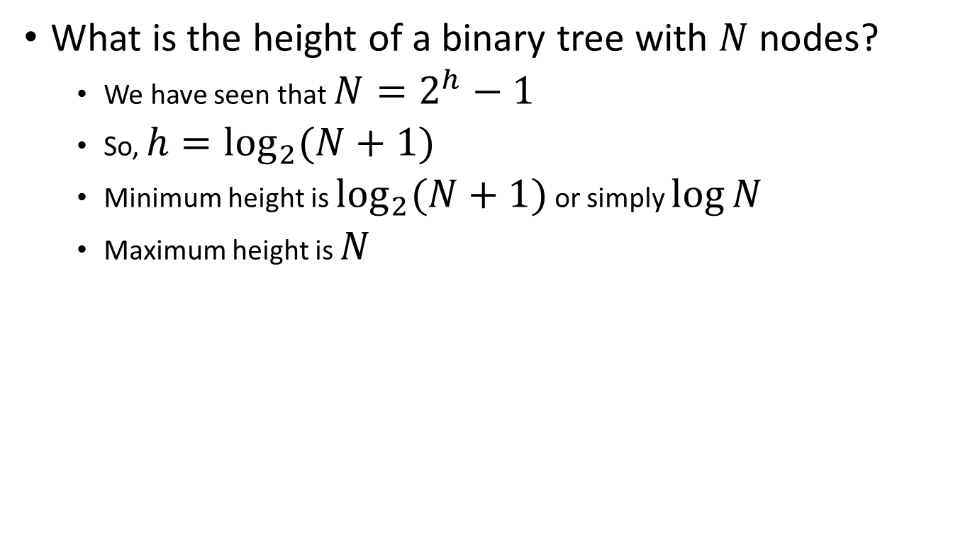
Binary Tree
Level 0
Level 1
Level 2

Slide 23
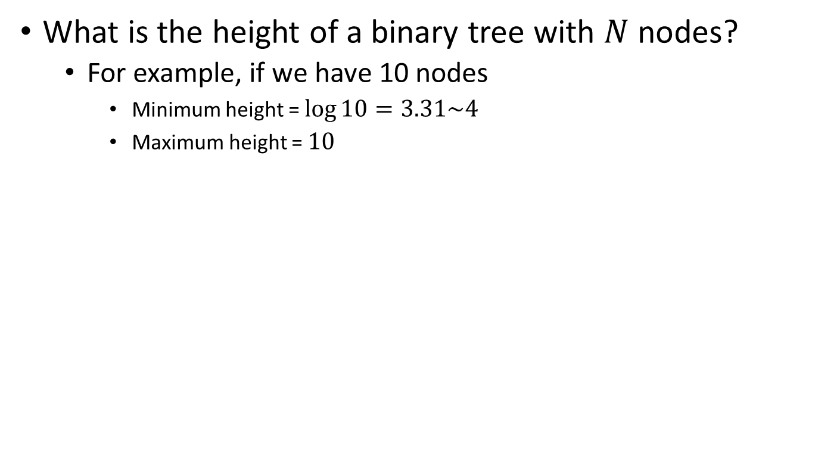
Binary Tree

Slide 24
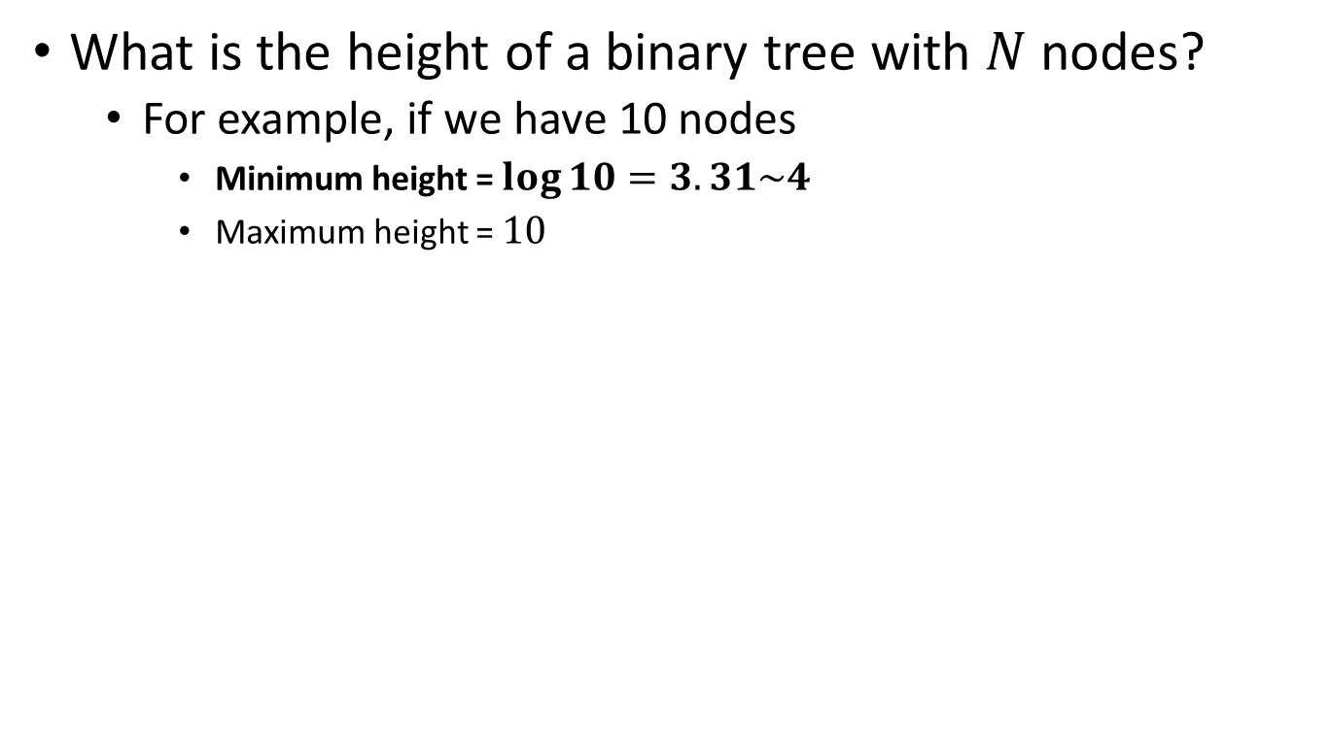
Binary Tree

Slide 25
Binary Tree
When tree is complete (best case)

Slide 26
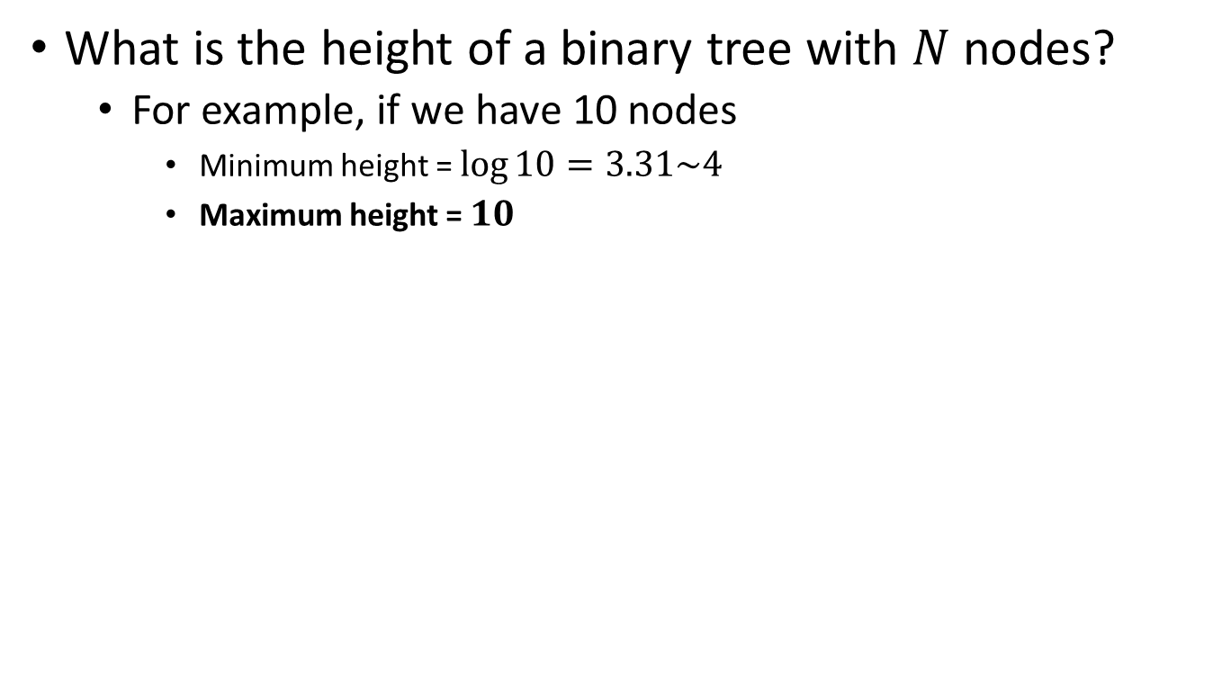
Binary Tree

Slide 27
Binary Tree
When each node has one child (worst case)

Slide 28
Binary Search Trees
Key property
Value at any node
Larger than the value of left child
Which means that it is larger than all values in left subtree
Smaller or equal to the value of right child
Which means that it is smaller than all values in right subtree
10
2
12

Slide 29
Binary Search Trees
Examples
5
10
10
2
45
5
30
5
45
30
2
25
45
2
25
30
10
25

Slide 30
Binary Search Trees
Examples
5
10
10
2
45
5
30
5
45
30
2
25
45
2
25
30
10
25
Binary search trees
Not a binary search tree

Slide 31
Binary Search Tree Specification
Structure: | The placement of each element in the binary tree must satisfy the binary search property: The value of the key of an element is greater than the value of the key of any element in its left subtree, and less than the value of the key of any element in its right subtree.
Operations:
MakeEmpty
Function | Initializes tree to empty state.
Postcondition | Tree exists and is empty.
Boolean IsEmpty
Function | Determines whether tree is empty.
Postcondition | Returns true if tree is empty and false otherwise.
Boolean IsFull
Function | Determines whether tree is full.
Postcondition | Returns true if tree is full and false otherwise.

Slide 32
Binary Search Tree Specification
int LengthIs
Function | Determines the number of elements in tree.
Postcondition | Returns the number of elements in tree.
RetrieveItem(ItemType& item. Boolean& found)
Function | Retrieves item whose key matches item's key (if present).
Precondition | Key member of item is initialized.
Postcondition | If there is an element someItem whose key matches item's key, then found = true and item is a copy of someItem; otherwise, found = false and item is unchanged. Tree is unchanged.
InsertItem(ItemType item)
Function | Adds item to tree.
Precondition | Tree is not full. item is not in tree.
Postcondition | item is in tree. Binary search property is maintained.

Slide 33
Binary Search Tree Specification
DeleteItem(ItemType item)
Function | Deletes the element whose key matches item's key.
Precondition | Key member of item is initialized. One and only one element in tree has a key matching item's key.
Postcondition | No element in tree has a key matching item's key.
Print()
Function | Prints the values in the tree in ascending key order.
Postcondition | Items in the tree are printed in ascending key order.

Slide 34
Binary Search Tree Specification
ResetTree(OrderType order)
Function | Initializes current position for an iteration through the tree in OrderType order.
Postcondition | Current position is prior to root of tree.
GetNextItem(ItemType& item, OrderType order, Boolean& finished)
Function | Gets the next element in tree.
Precondition | Current position is defined. Element at current position is not last in tree.
Postcondition | Current position is one position beyond current position at entry to GetNextItem. finished = (current position is last in tree). item is a copy of element at current position.

Slide 35
Implementing the Nodes in Binary Search Tree
left
info
right
struct TreeNode
{
ItemType info;
TreeNode *left;
TreeNode *right;
};

Slide 36
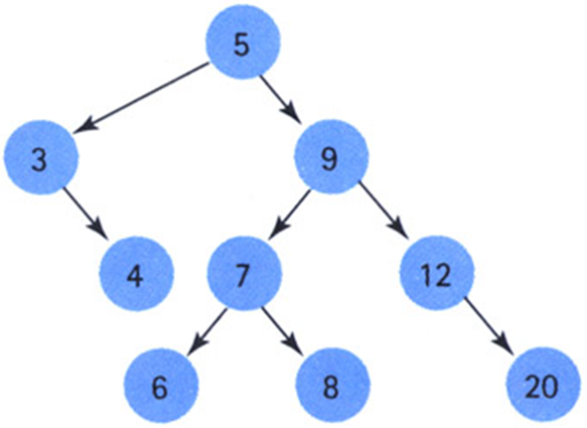
Implementing the Nodes in Binary Search Tree
left
info
right
struct TreeNode
{
ItemType info;
TreeNode *left;
TreeNode *right;
};
TreeNode *root
5
3
9
4
7
12
6
8
20

Slide 37
binarysearchtree.h
#ifndef BINARYSEARCHTREE_H_INCLUDED
#define BINARYSEARCHTREE_H_INCLUDED
typedef char ItemType;
struct TreeNode{ItemType info;TreeNode *left, *right;};
enum OrderType {PRE_ORDER, IN_ORDER, POST_ORDER};
class TreeType
{
public:
TreeType();
~TreeType();
void MakeEmpty();
bool IsEmpty();
bool IsFull();
int LengthIs();
void RetrieveItem(ItemType& item, bool& found);
void InsertItem(ItemType item);
void DeleteItem(ItemType item);
void ResetTree(OrderType order);
void GetNextItem(ItemType& item, OrderType order, bool& finished);
void Print();
private:
TreeNode* root;
};
#endif // BINARYSEARCHTREE_H_INCLUDED

Slide 38
binarysearchtree.cpp
#include "binarysearchtree.h"
#include <new>
TreeType::TreeType()
{
root = NULL;
}
bool TreeType::IsEmpty()
{
return root == NULL;
}
bool TreeType::IsFull()
{
TreeNode* location;
try
{
location = new TreeNode;
delete location;
return false;
}
catch(std::bad_alloc exception)
{
return true;
}
}

Slide 39
binarysearchtree.cpp
#include "binarysearchtree.h"
#include <new>
TreeType::TreeType()
{
root = NULL;
}
bool TreeType::IsEmpty()
{
return root == NULL;
}
bool TreeType::IsFull()
{
TreeNode* location;
try
{
location = new TreeNode;
delete location;
return false;
}
catch(std::bad_alloc exception)
{
return true;
}
}
O(1)
O(1)
O(1)

Slide 40
Function InsertItem
TreeNode *root

Slide 41
Function InsertItem
Insert 5
TreeNode *root

Slide 42
Function InsertItem
Insert 5
TreeNode *root
5

Slide 43
Function InsertItem
Insert 9
TreeNode *root
5

Slide 44
Function InsertItem
Insert 9
TreeNode *root
5
9

Slide 45
Function InsertItem
Insert 7
TreeNode *root
5
9

Slide 46
Function InsertItem
Insert 7
TreeNode *root
5
9
7

Slide 47
Function InsertItem
Insert 3
TreeNode *root
5
9
7

Slide 48
Function InsertItem
Insert 3
TreeNode *root
5
3
9
7

Slide 49
Function InsertItem
Insert 8
TreeNode *root
5
3
9
7

Slide 50
Function InsertItem
Insert 8
TreeNode *root
5
3
9
7
8

Slide 51
Function InsertItem
Insert 12
TreeNode *root
5
3
9
7
8

Slide 52
Function InsertItem
Insert 12
TreeNode *root
5
3
9
7
12
8

Slide 53
Function InsertItem
Insert 6
TreeNode *root
5
3
9
7
12
8

Slide 54
Function InsertItem
Insert 6
TreeNode *root
5
3
9
7
12
6
8

Slide 55
Function InsertItem
Insert 4
TreeNode *root
5
3
9
7
12
6
8

Slide 56
Function InsertItem
Insert 4
TreeNode *root
5
3
9
4
7
12
6
8

Slide 57
Function InsertItem
Insert 20
TreeNode *root
5
3
9
4
7
12
6
8

Slide 58
Function InsertItem
Insert 20
TreeNode *root
5
3
9
4
7
12
6
8
20

Slide 59
Function InsertItem
Pointer vs Reference to Pointer
#include <iostream>
using namespace std;
void f(int *addr)
{
int temp;
addr = &temp;
}
int main(void)
{
int x = 5, *y = &x;
cout << "y = " << y << endl;
f(y);
cout << "y = " << y << endl;
return 0;
}
#include <iostream>
using namespace std;
void f(int *&addr)
{
int temp;
addr = &temp;
}
int main(void)
{
int x = 5, *y = &x;
cout << "y = " << y << endl;
f(y);
cout << "y = " << y << endl;
return 0;
}
Output:
y = 0x28ff18
y = 0x28ff18
Output:
y = 0x28ff0c
y = 0x28fee4

Slide 60
Function InsertItem
void Insert(TreeNode *&tree, ItemType item)
{
if (tree == NULL)//Base case:Insertion place found.
{
tree = new TreeNode;
tree->right = NULL;
tree->left = NULL:
tree->info = item;
}
else if (item < tree->info)
Insert(tree->left, item);//General case 1:Insert in left subtree.
else
Insert(tree->right, item);//General case 2:Insert in right subtree.
}
void TreeType::InsertItem(ItemType item)
{
Insert(root, item):
}

Slide 61
Function InsertItem
root

Slide 62
Function InsertItem
InsertItem(5)
root

Slide 63
Function InsertItem
InsertItem(5)
root
Insert(root,5)

Slide 64
Function InsertItem
InsertItem(5)
root
Insert(root,5)
Base case

Slide 65
Function InsertItem
InsertItem(5)
root
Insert(root,5)
Base case
5

Slide 66
Function InsertItem
InsertItem(5)
root
5

Slide 67
Function InsertItem
root
5

Slide 68
Function InsertItem
InsertItem(9)
root
5

Slide 69
Function InsertItem
InsertItem(9)
root
Insert(root,9)
5

Slide 70
Function InsertItem
InsertItem(9)
root
Insert(root,9)
General case 2
5

Slide 71
Function InsertItem
InsertItem(9)
root
Insert(root,9)
General case 2
5
Insert(root->right,9)

Slide 72
Function InsertItem
InsertItem(9)
root
Insert(root,9)
General case 2
5
Insert(root->right,9)
Base case

Slide 73
Function InsertItem
InsertItem(9)
root
Insert(root,9)
General case 2
5
Insert(root->right,9)
Base case
9

Slide 74
Function InsertItem
InsertItem(9)
root
Insert(root,9)
General case 2
5
9

Slide 75
Function InsertItem
InsertItem(9)
root
5
9

Slide 76
Function InsertItem
root
5
9

Slide 77
Function InsertItem
InsertItem(7)
root
5
9

Slide 78
Function InsertItem
InsertItem(7)
root
Insert(root,7)
5
9

Slide 79
Function InsertItem
InsertItem(7)
root
Insert(root,7)
General case 2
5
9

Slide 80
Function InsertItem
InsertItem(7)
root
Insert(root,7)
General case 2
5
Insert(root->right,7)
9

Slide 81
Function InsertItem
InsertItem(7)
root
Insert(root,7)
General case 2
5
Insert(root->right,7)
General case 1
9

Slide 82
Function InsertItem
InsertItem(7)
root
Insert(root,7)
General case 2
5
Insert(root->right,7)
General case 1
9
Insert(root->right->left,7)

Slide 83
Function InsertItem
InsertItem(7)
root
Insert(root,7)
General case 2
5
Insert(root->right,7)
General case 1
9
Insert(root->right->left,7)
Base case

Slide 84
Function InsertItem
InsertItem(7)
root
Insert(root,7)
General case 2
5
Insert(root->right,7)
General case 1
9
Insert(root->right->left,7)
Base case
7

Slide 85
Function InsertItem
InsertItem(7)
root
Insert(root,7)
General case 2
5
Insert(root->right,7)
General case 1
9
7

Slide 86
Function InsertItem
InsertItem(7)
root
Insert(root,7)
General case 2
5
9
7

Slide 87
Function InsertItem
InsertItem(7)
root
5
9
7

Slide 88
Function InsertItem
root
5
9
7

Slide 89
Function InsertItem
InsertItem(3)
root
5
9
7

Slide 90
Function InsertItem
InsertItem(3)
root
Insert(root,3)
5
9
7

Slide 91
Function InsertItem
InsertItem(3)
root
Insert(root,3)
General case 1
5
9
7

Slide 92
Function InsertItem
InsertItem(3)
root
Insert(root,3)
General case 1
5
Insert(root->left,3)
9
7

Slide 93
Function InsertItem
InsertItem(3)
root
Insert(root,3)
General case 1
5
Insert(root->left,3)
Base case
9
7

Slide 94
Function InsertItem
InsertItem(3)
root
Insert(root,3)
General case 1
5
Insert(root->left,3)
Base case
3
9
7

Slide 95
Function InsertItem
InsertItem(3)
root
Insert(root,3)
General case 1
5
3
9
7

Slide 96
Function InsertItem
InsertItem(3)
root
5
3
9
7

Slide 97
Function InsertItem
root
5
3
9
7

Slide 98
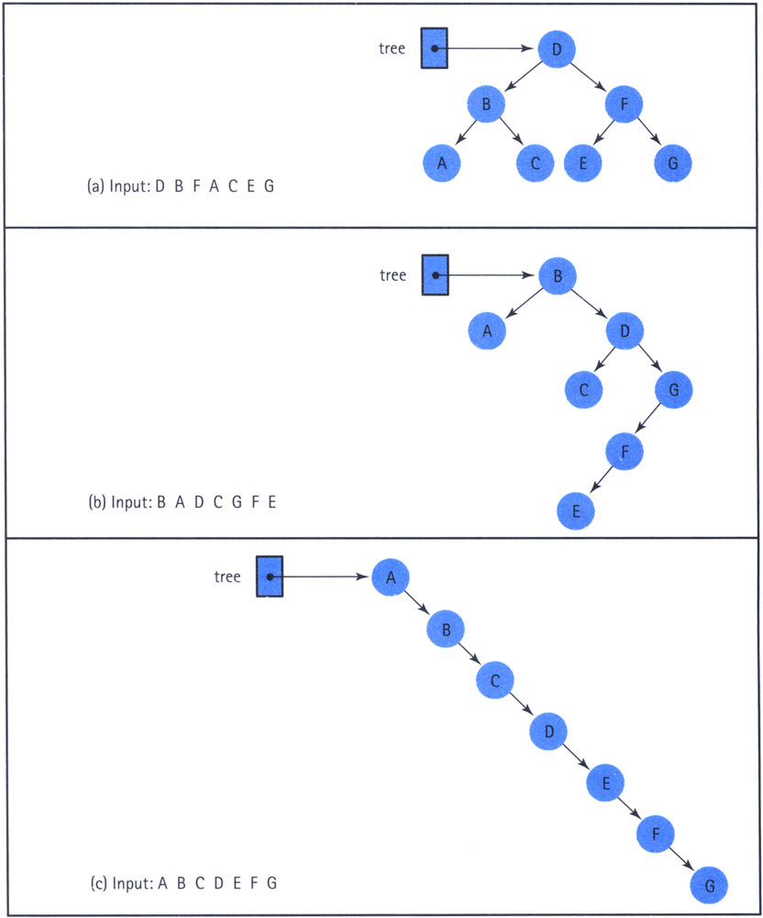
Function InsertItem
Impact of order of insertion on tree height

Slide 99
Function InsertItem
Impact of order of insertion on tree height

Slide 100
Function InsertItem
Impact of order of insertion on tree height

Slide 101
Function InsertItem
void Insert(TreeNode *&tree, ItemType item)
{
if (tree == NULL)//Base case:Insertion place found.
{
tree = new TreeNode;
tree->right = NULL;
tree->left = NULL:
tree->info = item;
}
else if (item < tree->info)
Insert(tree->left, item);//General case 1:Insert in left subtree.
else
Insert(tree->right, item);//General case 2:Insert in right subtree.
}
void TreeType::InsertItem(ItemType item)
{
Insert(root, item):
}
Worst case: O(N)
Best case: O(logN)

Slide 103
Function LengthIs
Calculate the number of nodes in the tree recursively
If tree is empty (base case)
length = 0
If tree is non-empty (general case)
Length = number of nodes in the left subtree + number of nodes in the right subtree + 1
Number of nodes in left subtree + 1 + Number of nodes in right subtree

Slide 104
Function LengthIs
int CountNodes(TreeNode* tree)
{
if (tree == NULL)
return 0;
else
return CountNodes(tree->left) + CountNodes(tree->right) + 1;
}
int TreeType::LengthIs()
{
return CountNodes(root);
}

Slide 105
Function LengthIs
root
5
3
9
4
7
12
6
8
20

Slide 106
Function LengthIs
root
5
3
9
4
7
12
6
8
20

Slide 107
Function LengthIs
root
5
3
9
4
7
12
6
8
20

Slide 108
Function LengthIs
root
5
3
9
4
7
12
6
8
20

Slide 109
Function LengthIs
root
5
3
9
0
4
7
12
6
8
20

Slide 110
Function LengthIs
root
5
3
9
0
4
7
12
6
8
20

Slide 111
Function LengthIs
root
5
3
9
0
4
7
12
6
8
20

Slide 112
Function LengthIs
root
5
3
9
0
4
7
12
0
6
8
20

Slide 113
Function LengthIs
root
5
3
9
0
4
7
12
0
6
8
20

Slide 114
Function LengthIs
root
5
3
9
0
4
7
12
0
0
6
8
20

Slide 115
Function LengthIs
root
5
3
9
0
1
4
7
12
0
0
6
8
20

Slide 116
Function LengthIs
root
5
3
9
0
1
4
7
12
0
0
6
8
20

Slide 117
Function LengthIs
root
5
2
3
9
0
1
4
7
12
0
0
6
8
20

Slide 118
Function LengthIs
root
5
2
3
9
0
1
4
7
12
0
0
6
8
20

Slide 119
Function LengthIs
root
5
2
3
9
0
1
4
7
12
0
0
6
8
20

Slide 120
Function LengthIs
root
5
2
3
9
0
1
4
7
12
0
0
6
8
20

Slide 121
Function LengthIs
root
5
2
3
9
0
1
4
7
12
0
0
6
8
20

Slide 122
Function LengthIs
root
5
2
3
9
0
1
4
7
12
0
0
6
8
20
0

Slide 123
Function LengthIs
root
5
2
3
9
0
1
4
7
12
0
0
6
8
20
0

Slide 124
Function LengthIs
root
5
2
3
9
0
1
4
7
12
0
0
6
8
20
0
0

Slide 125
Function LengthIs
root
5
2
3
9
0
1
4
7
12
0
0
6
8
20
0
0

Slide 126
Function LengthIs
root
5
2
3
9
0
1
4
7
12
0
0
1
6
8
20
0
0

Slide 127
Function LengthIs
root
5
2
3
9
0
1
4
7
12
0
0
1
6
8
20
0
0

Slide 128
Function LengthIs
root
5
2
3
9
0
1
4
7
12
0
0
1
6
8
20
0
0

Slide 129
Function LengthIs
root
5
2
3
9
0
1
4
7
12
0
0
1
6
8
20
0
0
0

Slide 130
Function LengthIs
root
5
2
3
9
0
1
4
7
12
0
0
1
6
8
20
0
0
0

Slide 131
Function LengthIs
root
5
2
3
9
0
1
4
7
12
0
0
1
6
8
20
0
0
0
0

Slide 132
Function LengthIs
root
5
2
3
9
0
1
4
7
12
0
0
1
6
8
20
0
0
0
0

Slide 133
Function LengthIs
root
5
2
3
9
0
1
4
7
12
0
0
1
1
6
8
20
0
0
0
0

Slide 134
Function LengthIs
root
5
2
3
9
0
1
4
7
12
0
0
1
1
6
8
20
0
0
0
0

Slide 135
Function LengthIs
root
5
2
3
9
0
1
3
4
7
12
0
0
1
1
6
8
20
0
0
0
0

Slide 136
Function LengthIs
root
5
2
3
9
0
1
3
4
7
12
0
0
1
1
6
8
20
0
0
0
0

Slide 137
Function LengthIs
root
5
2
3
9
0
1
3
4
7
12
0
0
1
1
6
8
20
0
0
0
0

Slide 138
Function LengthIs
root
5
2
3
9
0
1
3
4
7
12
0
0
1
1
0
6
8
20
0
0
0
0

Slide 139
Function LengthIs
root
5
2
3
9
0
1
3
4
7
12
0
0
1
1
0
6
8
20
0
0
0
0

Slide 140
Function LengthIs
root
5
2
3
9
0
1
3
4
7
12
0
0
1
1
0
6
8
20
0
0
0
0

Slide 141
Function LengthIs
root
5
2
3
9
0
1
3
4
7
12
0
0
1
1
0
6
8
20
0
0
0
0
0

Slide 142
Function LengthIs
root
5
2
3
9
0
1
3
4
7
12
0
0
1
1
0
6
8
20
0
0
0
0
0

Slide 143
Function LengthIs
root
5
2
3
9
0
1
3
4
7
12
0
0
1
1
0
6
8
20
0
0
0
0
0
0

Slide 144
Function LengthIs
root
5
2
3
9
0
1
3
4
7
12
0
0
1
1
0
6
8
20
0
0
0
0
0
0

Slide 145
Function LengthIs
root
5
2
3
9
0
1
3
4
7
12
0
0
1
1
0
1
6
8
20
0
0
0
0
0
0

Slide 146
Function LengthIs
root
5
2
3
9
0
1
3
4
7
12
0
0
1
1
0
1
6
8
20
0
0
0
0
0
0

Slide 147
Function LengthIs
root
5
2
3
9
0
1
3
2
4
7
12
0
0
1
1
0
1
6
8
20
0
0
0
0
0
0

Slide 148
Function LengthIs
root
5
2
3
9
0
1
3
2
4
7
12
0
0
1
1
0
1
6
8
20
0
0
0
0
0
0

Slide 149
Function LengthIs
root
5
2
6
3
9
0
1
3
2
4
7
12
0
0
1
1
0
1
6
8
20
0
0
0
0
0
0

Slide 150
Function LengthIs
root
5
2
6
3
9
0
1
3
2
4
7
12
0
0
1
1
0
1
6
8
20
0
0
0
0
0
0

Slide 151
Function LengthIs
9
root
5
2
6
3
9
0
1
3
2
4
7
12
0
0
1
1
0
1
6
8
20
0
0
0
0
0
0

Slide 152
Function LengthIs
int CountNodes(TreeNode* tree)
{
if (tree == NULL)
return 0;
else
return CountNodes(tree->left) + CountNodes(tree->right) + 1;
}
int TreeType::LengthIs()
{
return CountNodes(root);
}
O(N)

